Slide 1

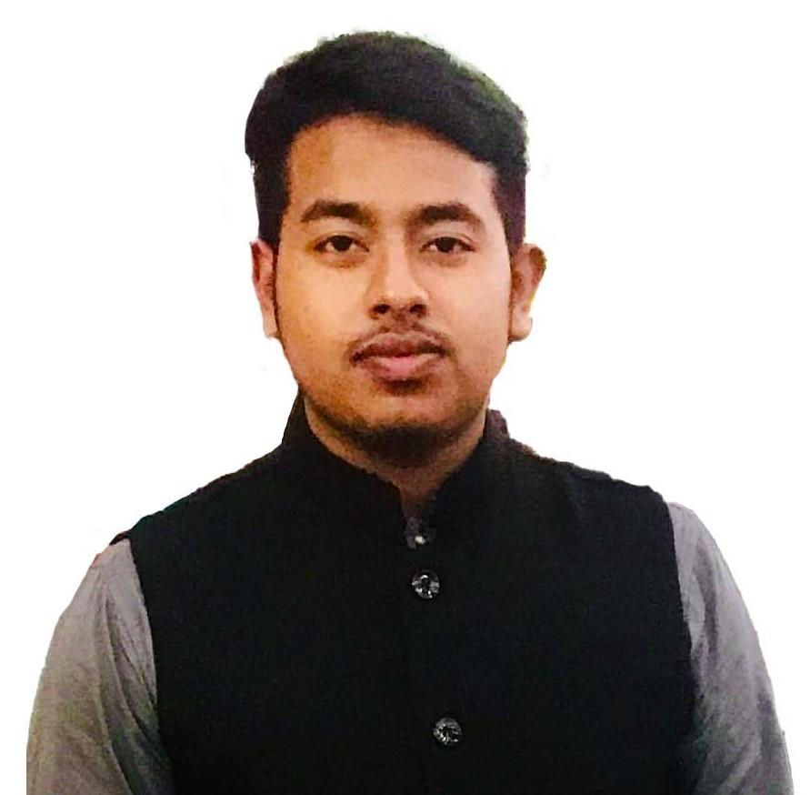
Co processor
By Mohammed Ahsan Meah

Slide 2
